Slide 1
DevOps and the Database: How to INSERT value into your pipelines
Chris Unwin, Compliant DevOps Specialist – Redgate Software

Slide 2


A little bit about me…
Chris Unwin
Compliant DevOps Specialist
Chris.Unwin@red-gate.com
/in/christopherunwincambridge/
DBAle on Spotify and iTunes

Slide 3
Agenda
What is DevOps?
Extending DevOps practices to the database
What is stopping us adopting DevOps?
Expanding the definition of DevOps

Slide 4
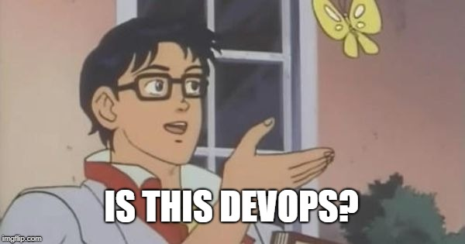
MANAGERS
DEVELOPERS
VENDORS
MORE FEATURES
AUTOMATION
TOOLS

Slide 5
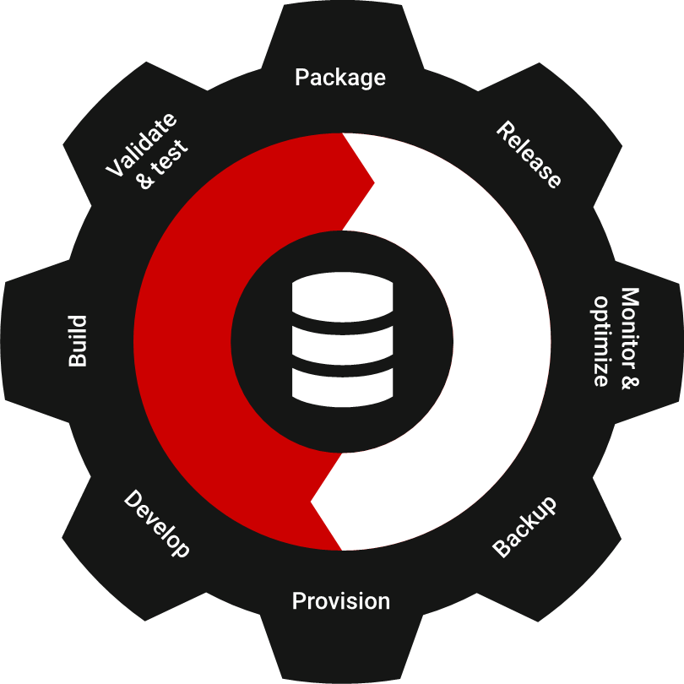
What is DevOps?
“DevOps is the union of people, process, and products to enable continuous delivery of value to our end users.”
Donovan Brown,
Principal DevOps Program Manager, Microsoft

Slide 6
Extending DevOps to databases:
Repeatability of processes
Greater predictability over releases
Faster speed of response to change
Greater reliability of the release process
Overall faster delivery of business value

Slide 7
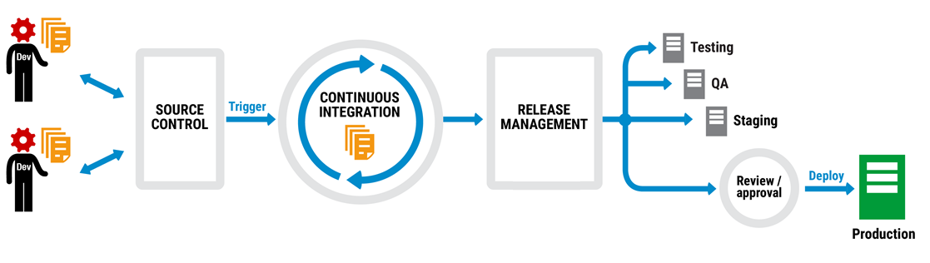
We’re already automating application deployments

Slide 8
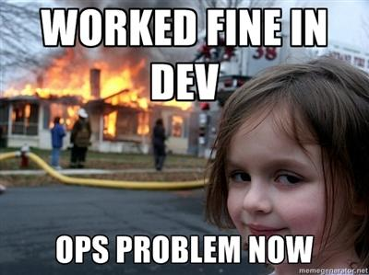
A complete process means less of this…

Slide 9
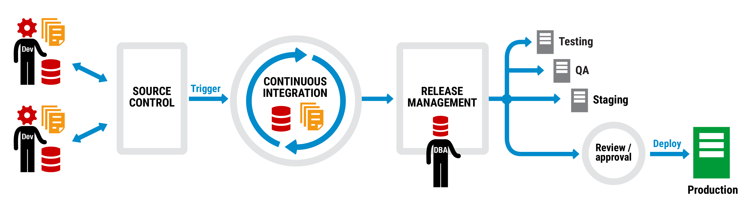
Application and database deployment pipeline

Slide 10
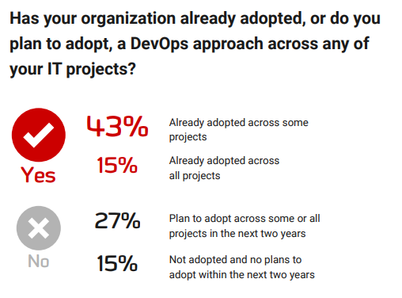
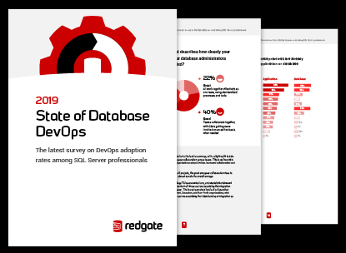

Slide 11

But what stops us adopting this process?

Slide 12
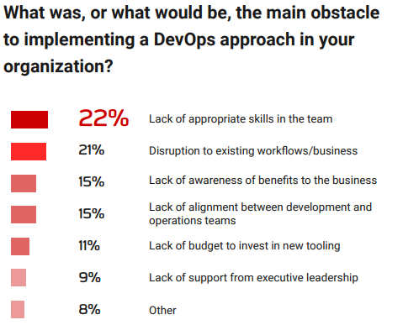

Slide 13
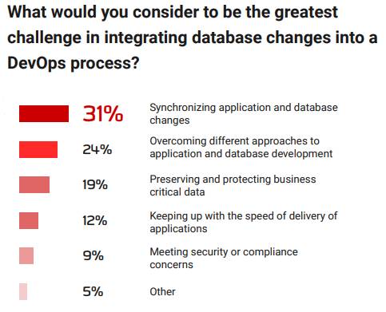
Notes:
You can see here, that over half of people we asked are already adopting DevOps across all or some of their projects. This is a 10% increase from last year, and a clear demonstration that DevOps is firmly established in the mainstream. A further 30% plan to adopt during the next two years, leaving just 18% of respondents having no current plans to adopt a DevOps approach within their organization within the next two years.
I’m assuming based on your attendance to today’s webinar that you’re already adopting or have plans to adopt DevOps in your organization. But where does the database fit into these plans?

Slide 14
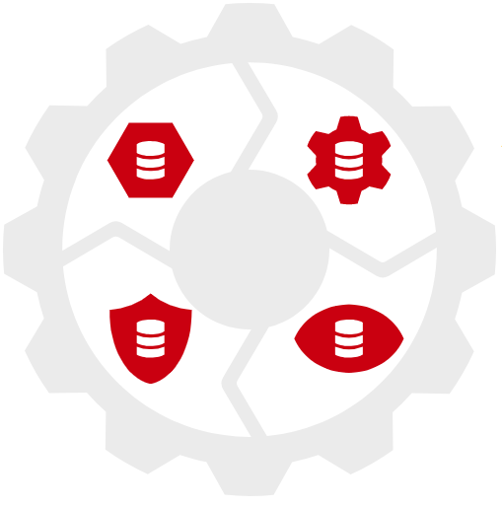




4 Elements of Compliant Database DevOps

Slide 15
A complete database DevOps process

Slide 16

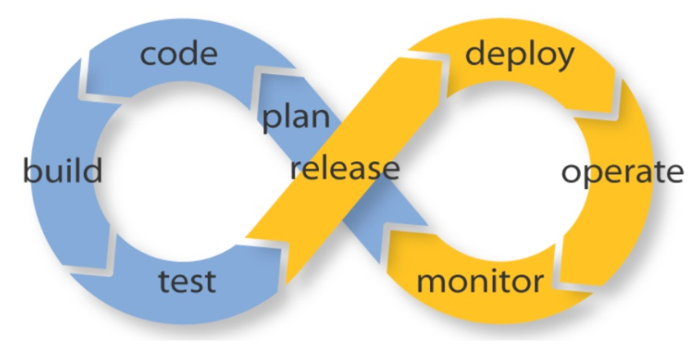
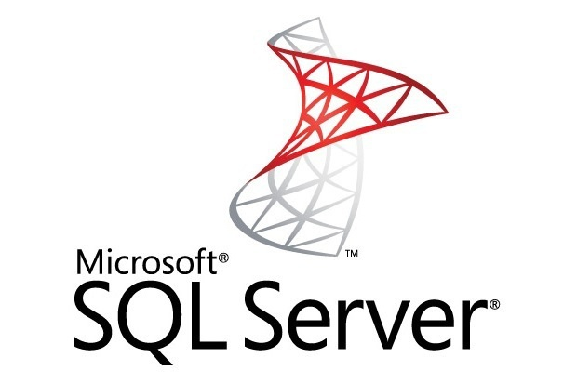

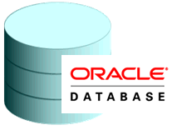



Remember, this isn’t tool or even platform specific…

Slide 17
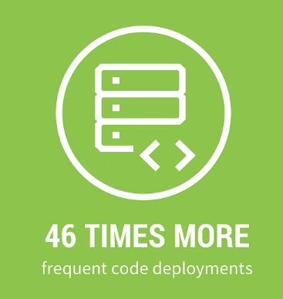
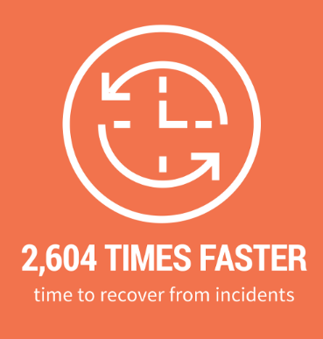
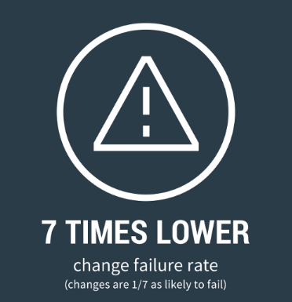
2018 DORA ’Accelerate: State of DevOps’ Report

Slide 18
Any Questions?

Slide 19
References & Sources
DORA Accelerate Report: https://devops-research.com/2018/08/announcing-accelerate-state-of-devops-2018/
Redgate State of DB DevOps Report: https://www.red-gate.com/solutions/database-devops/report-2019
Worked fine in Dev meme: http://www.developermemes.com/2013/12/13/worked-fine-dev-ops-problem-now/
Jenkins: https://jenkins.io/
Bamboo: https://www.atlassian.com/software/bamboo
Azure DevOps: https://azure.microsoft.com/en-gb/services/devops/
Octopus Deploy: https://octopus.com/

